Slide 1
Cryptocurrency value formation
An empirical study leading to a cost of production model for valuing Bitcoin
Adam S. Hayes
University of Wisconsin-Madison
Ke Xu
Olin Business School
Washington University in St. Louis

Slide 2
Virtual world
Altcoins
Bitcoin
Real world

Slide 3
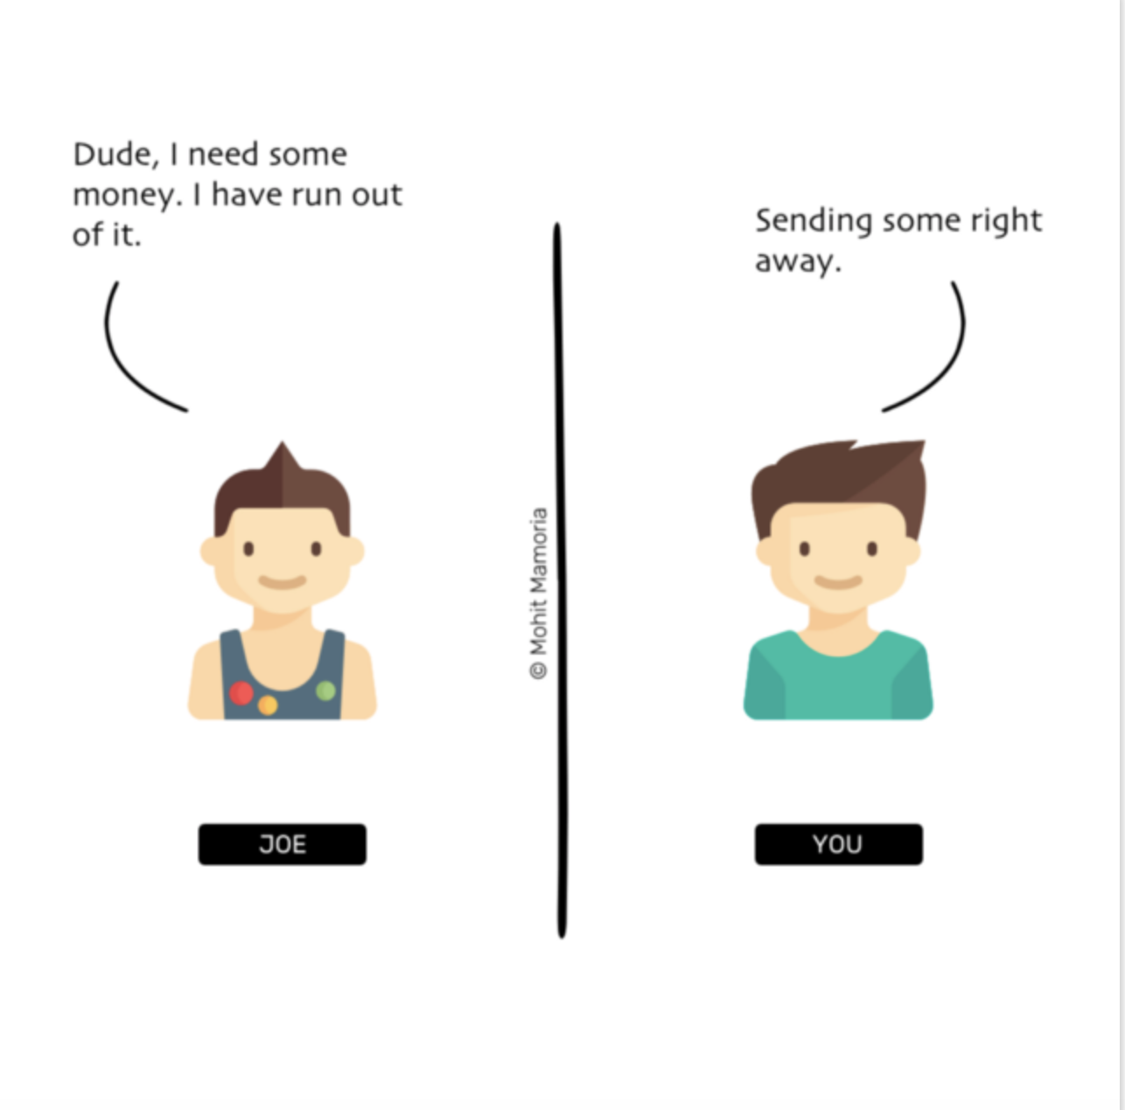
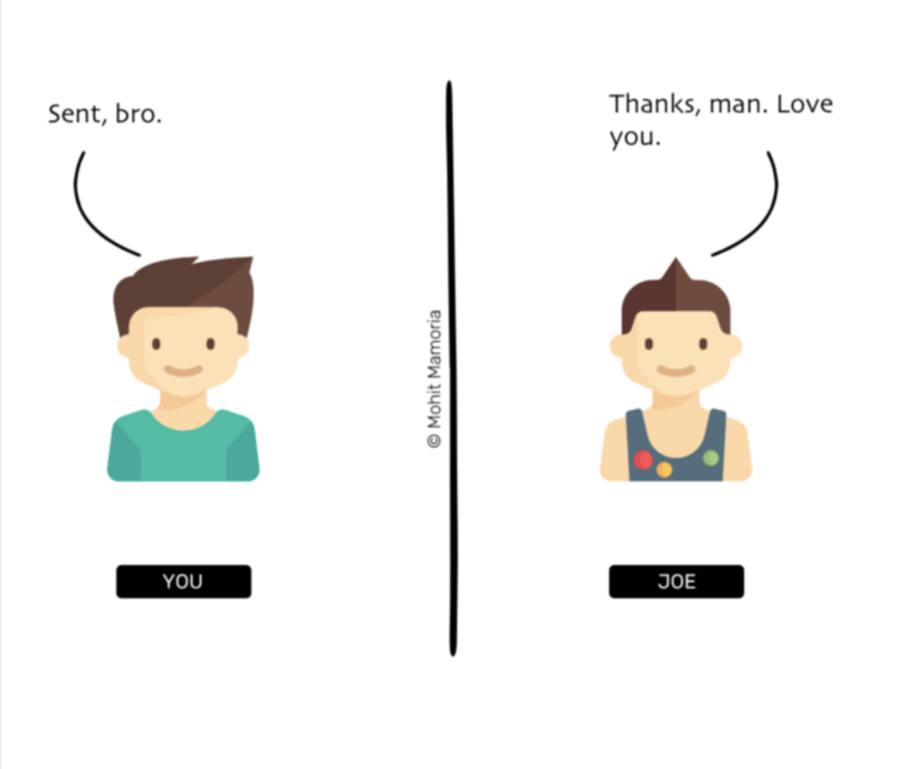

Slide 5
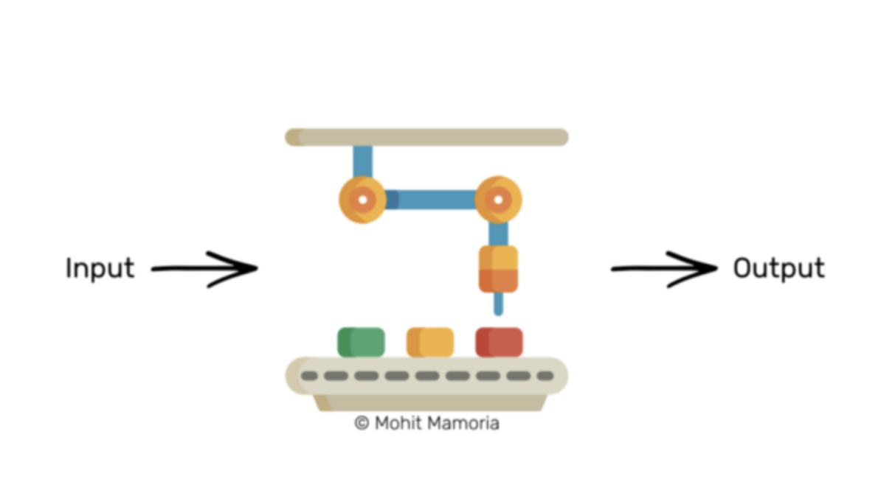
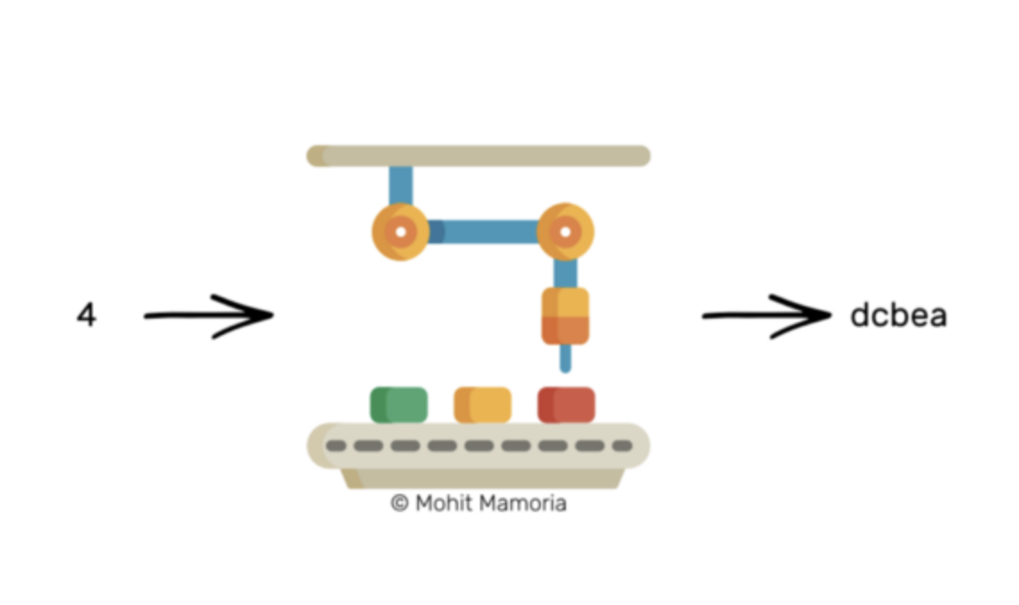
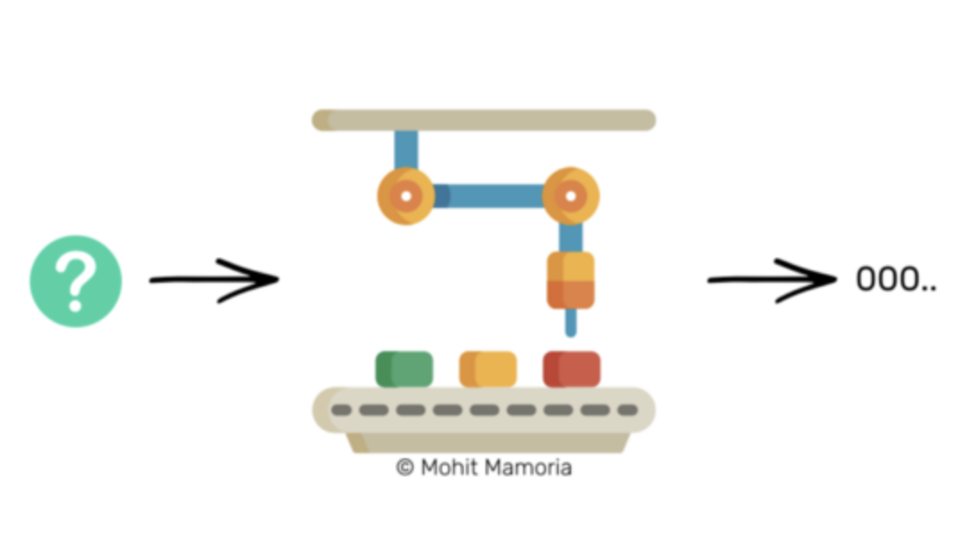
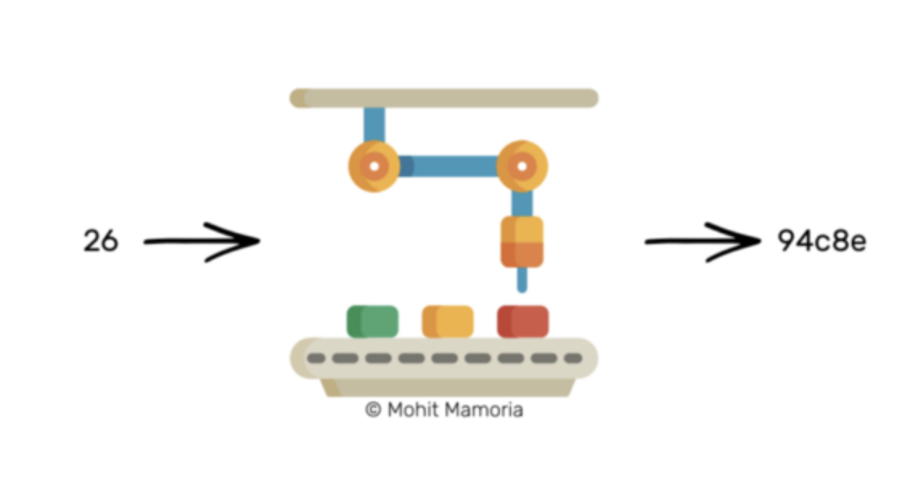

Slide 6
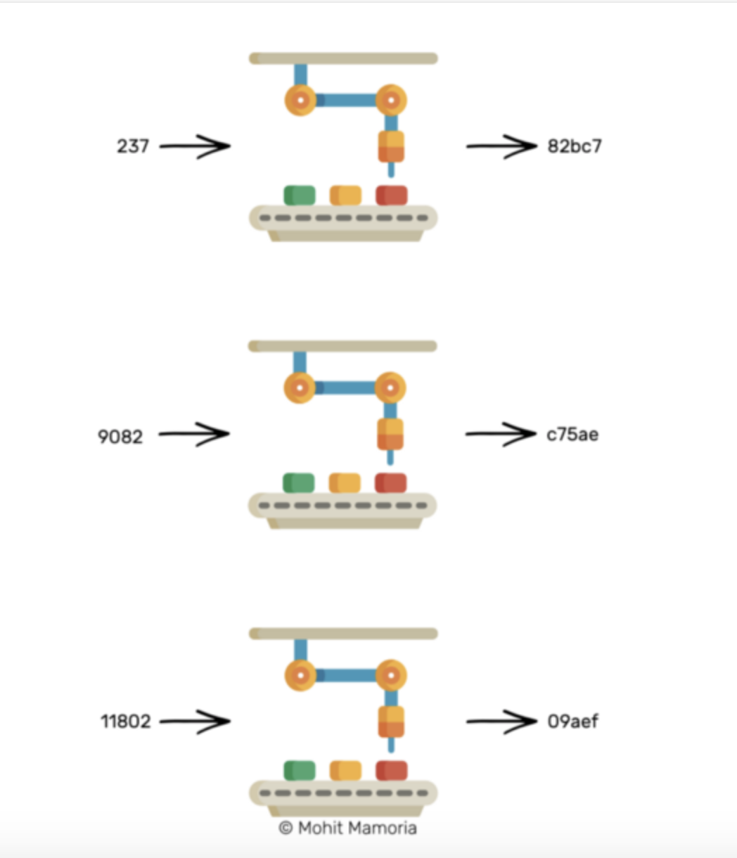
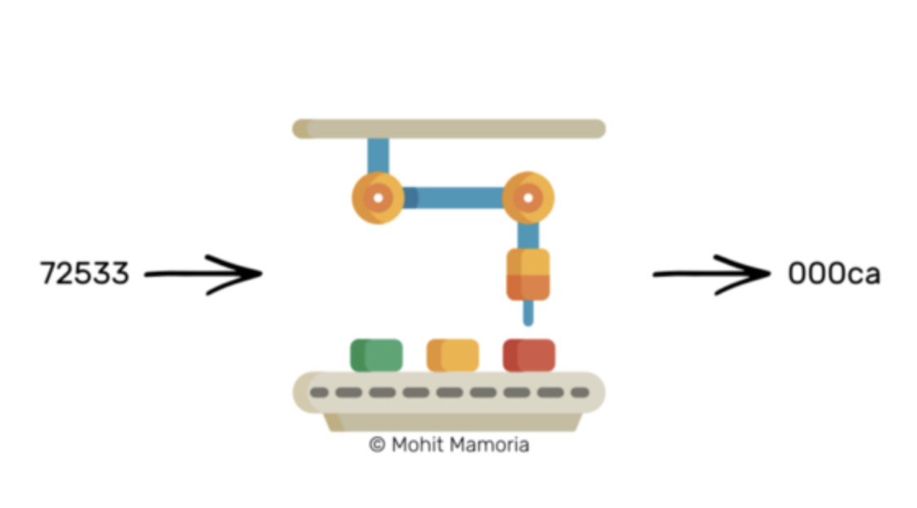

Slide 7
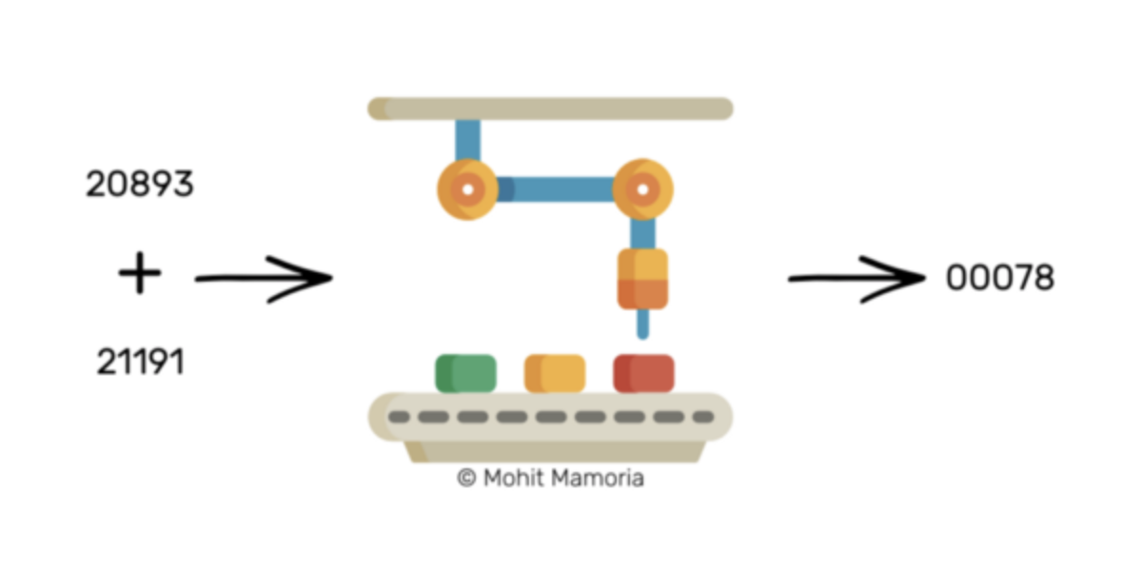
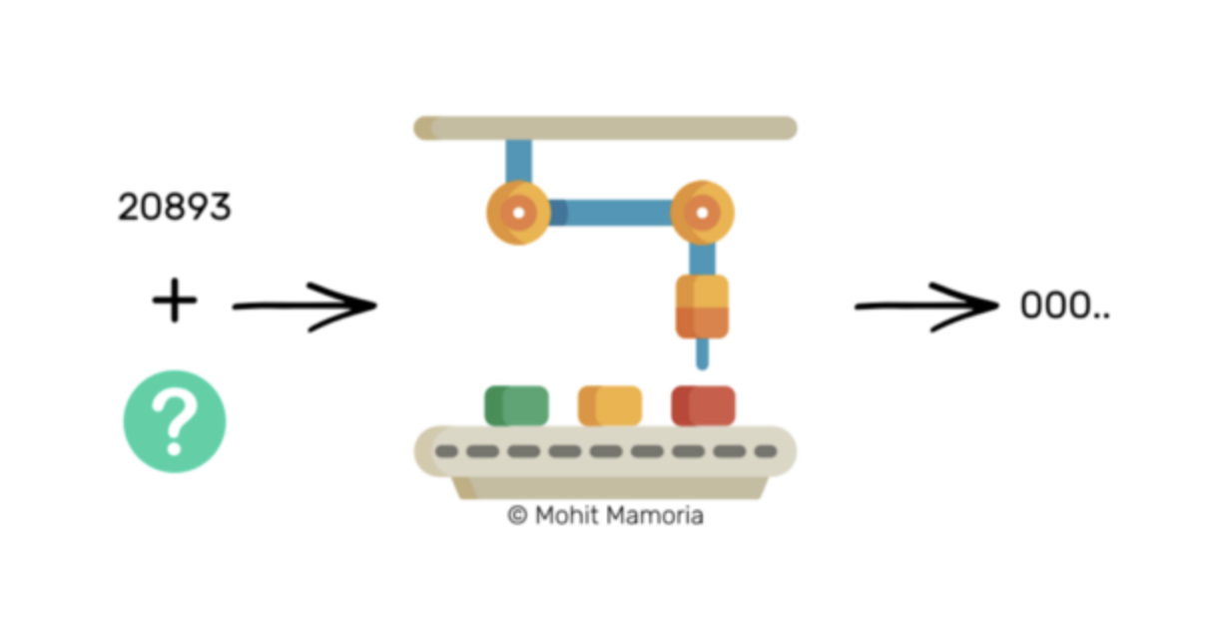
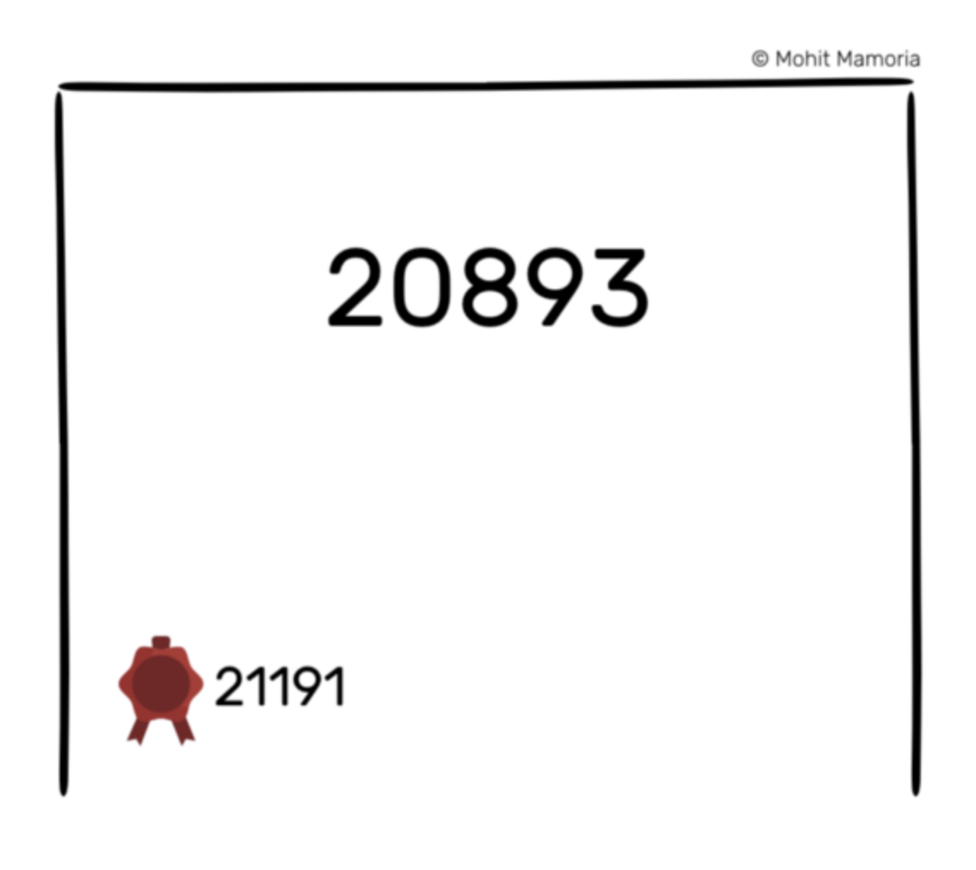

Slide 8
What if someone say “I could not get the right output with the seal number”
He might have misheard the transactions that were announced in the network
He might have miswritten the transactions that were announced in the network
He might have tried to cheat or be dishonest when writing transactions, either to favor himself or someone else in the network
Whatever sealing number the majority agrees upon, becomes the honest sealing number.
The rewards make everyone keep working in the network

Slide 9
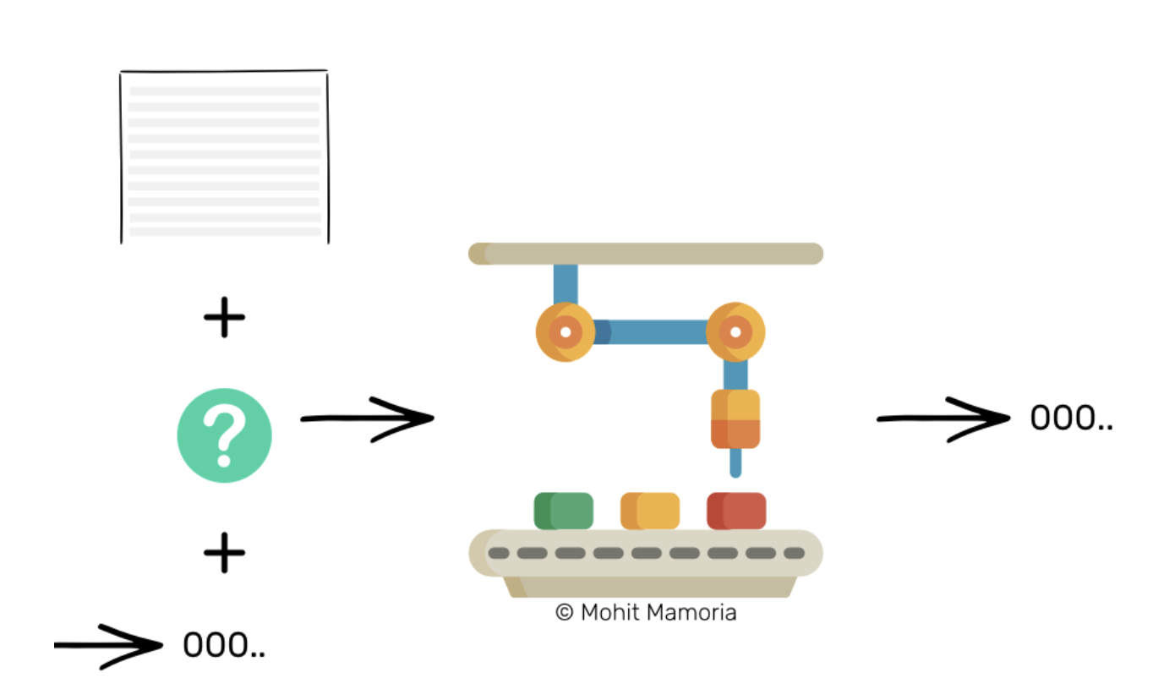
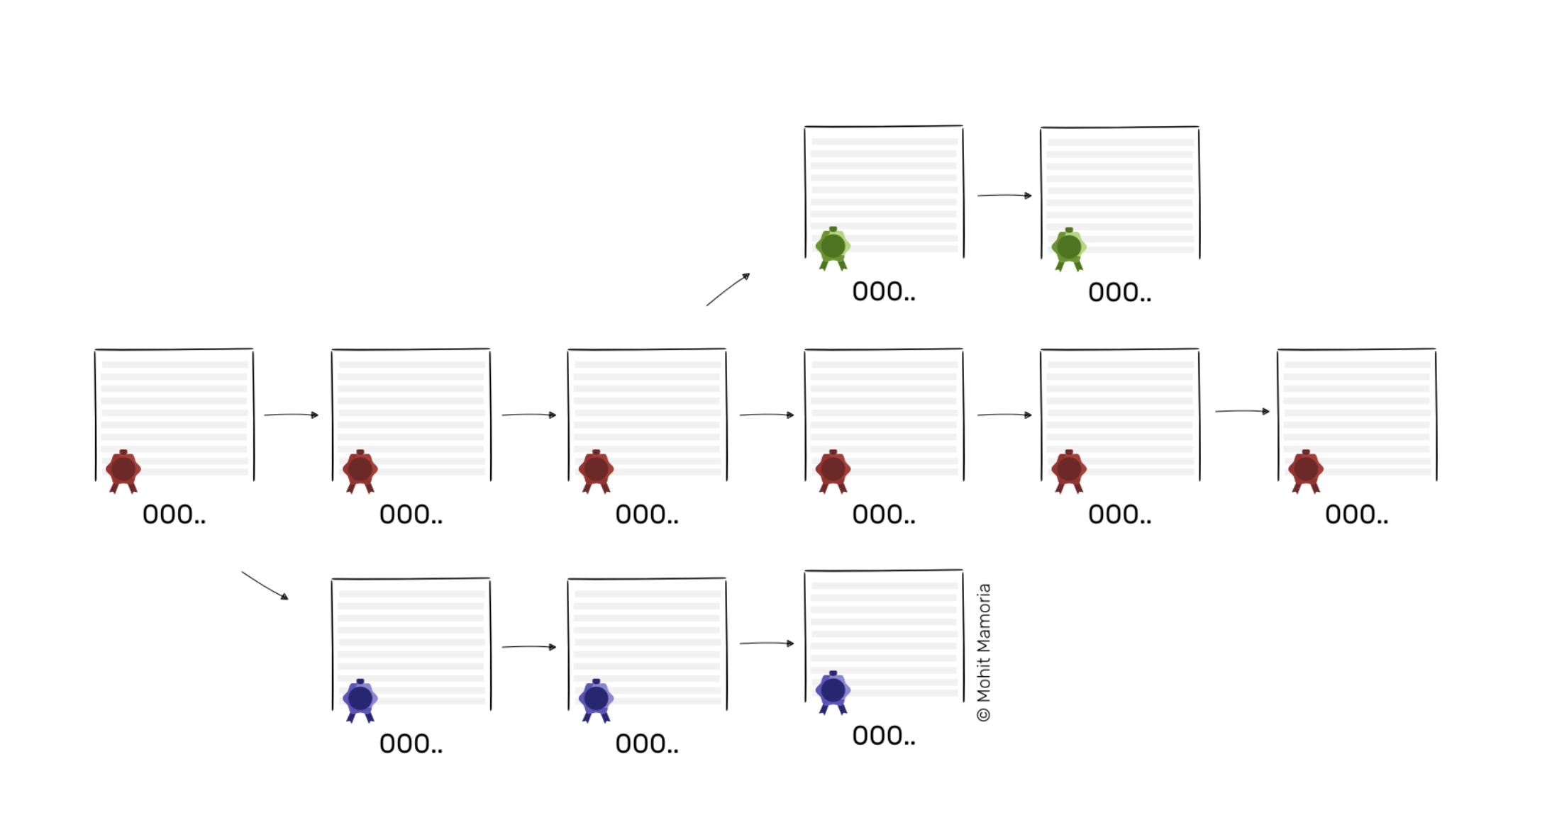

Slide 10
What if the majority of the people tend to be dishonest?
51% attack!

Slide 11
Virtual world
Altcoins
Bitcoin
Real world

Slide 12
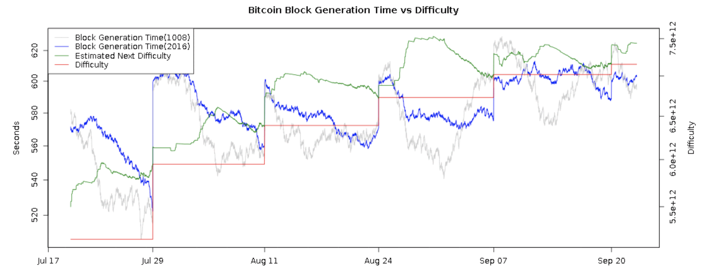
Fundamental variables
Total money supply
Block Reward
Block Time
Difficulty Level
Market Price
Algorithm
21,000,000 for Bitcoin and no more
Relatively stable, 12.5 coins per block now, halved per 4 years approximately
Around 10 minutes
Difficulty retarget mechanism, per 2016 blocks
Observed pair prices of Altcoin/Bitcoin on exchanges
Cryptologic hash function used as the basis for the protocol, SHA-256d

Slide 13
No arbitrage
Bitcoin is the stable equilibrium digital currency
Competition of capital
Arbitrage
Removing the opportunity
Mining Bitcoin
Mining Altcoins
Mobility of capital in switching mining
Market exchange rate adjusts
Baseline: rate of return for bitcoin mining
(expected bitcoins per day per unit of mining power)

Slide 14
$$BlockTime= \frac{difficulty × 2^{32}}{hashrate}$$
$$BTC per day=BlockReward × \frac{3600 × 24}{BlockTime}$$
$$BTC per day= \frac{βρ}{δ}∙θ$$
Where $β$ is the block reward
$ρ$ is the hashing power employed by a miner
$δ$ is the difficulty level
$θ$ summarized the constants
$${BTC per day}_{altcoin}= \left(\frac{β_{altcoin}ρ}{δ_{altcoin}}∙θ\right)∙ε$$
Theoretical equilibrium market price(bid): $ε^{∗} =\frac{BTC per day}{\frac{β_{altcoin}}{δ_{altcoin}}∙θ}$

Slide 15
No arbitrage
Competition of capital
Arbitrage
Removing the opportunity
Mining Bitcoin
Mining Altcoins
Mobility of capital in switching mining
Market exchange rate adjusts
And alternatively, 33000 XYZ Coin/day
Current market bid = 0.00003996 BTC
33000 * 0.00003996 = 1.32 BTC/day
Alice could mine 1 BTC/day based on her mining power
Removing the opportunity

Slide 16
Virtual world
Altcoins
Bitcoin
Real world

Slide 17
Shut-down Price: a cost of production model
$$BlockTime= \frac{Difficulty × 2^{32}}{Hashrate}$$
$$BTC per day=BlockReward × \frac{3600 × 24}{BlockTime}$$
$$Marginal cost=OPEX per coin= \frac{OPEX}{BTC per day}$$

Slide 18
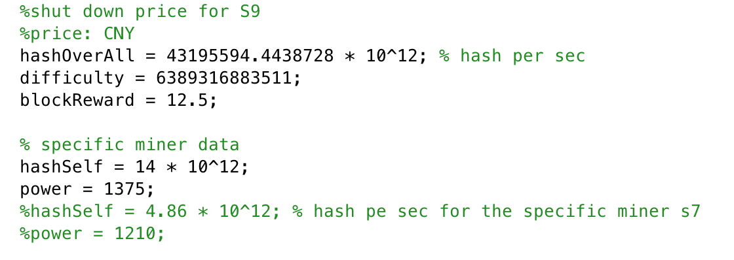
Shut-down Price: a cost of production model
26952
68322

Slide 19
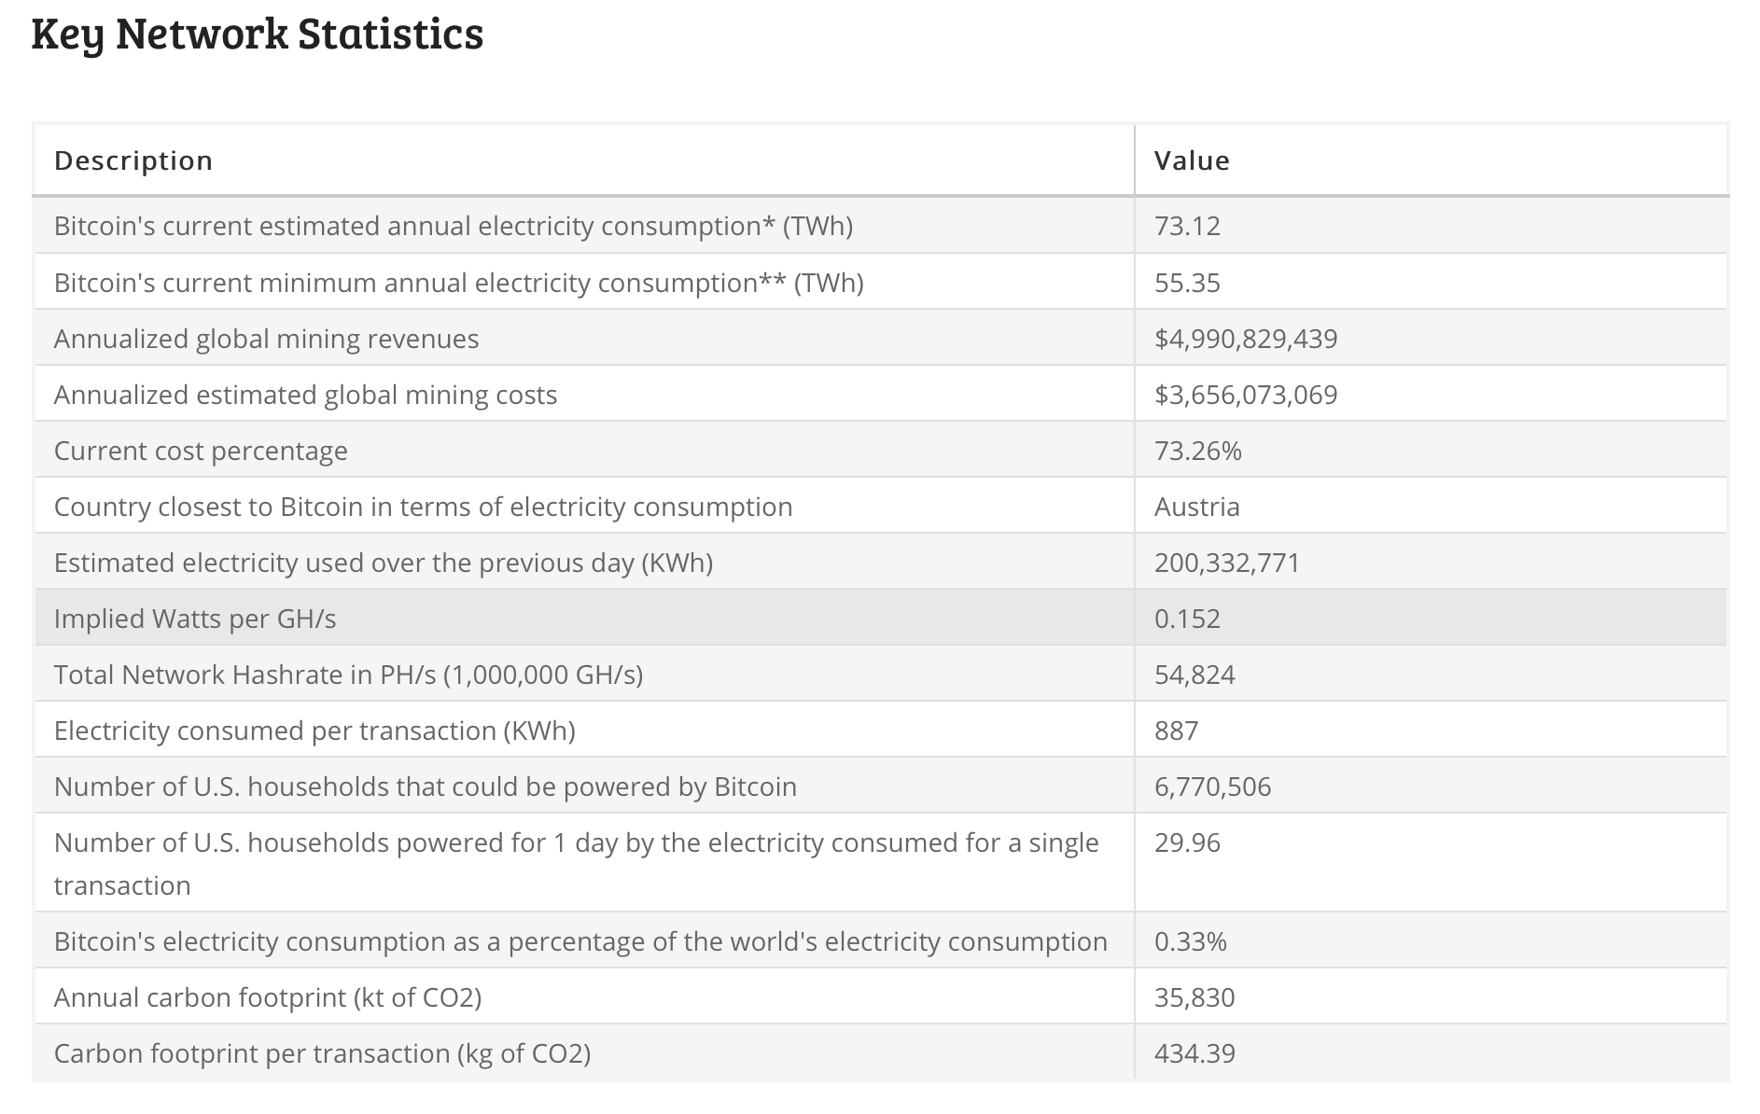
Shut-down Price: a cost of production model
Website: Digiconomist
Bitcoin Energy Consumption Index
https://digiconomist.net/bitcoin-energy-consumption

Slide 20
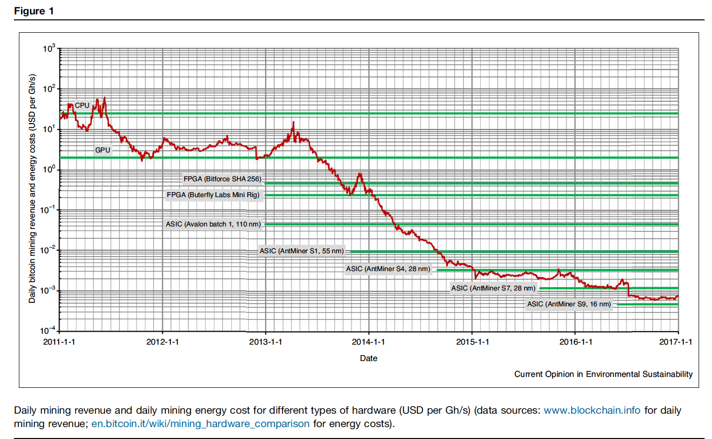

Slide 21
Shut-down Price: a cost of production model
$$BlockTime= \frac{Difficulty × 2^{32}}{Hashrate}$$
$$BTC per day=BlockReward × \frac{3600 × 24}{BlockTime}$$
$$Marginal cost=OPEX per coin= \frac{OPEX}{BTC per day}$$

Slide 22
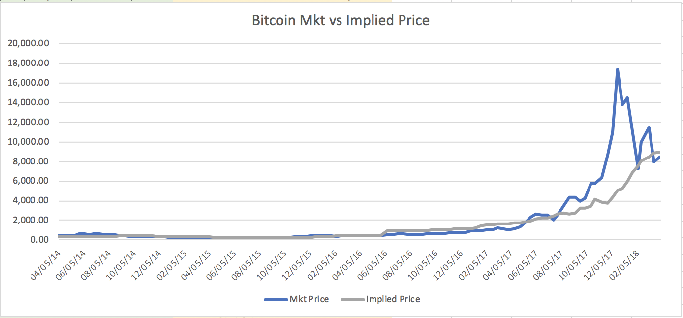
Shut-down Price: a cost of production model
In 2015
75.33 USD/MWh in Mexico
337.38 USD/MWh in Denmark
35.34 USD/MWh Norway
263.33 USD/MWh in Italy
Competitive prices:
(Abundant hydro power)
South west of China
North American continent

Slide 23
Virtual world
Altcoins
Bitcoin
Real world

Slide 24
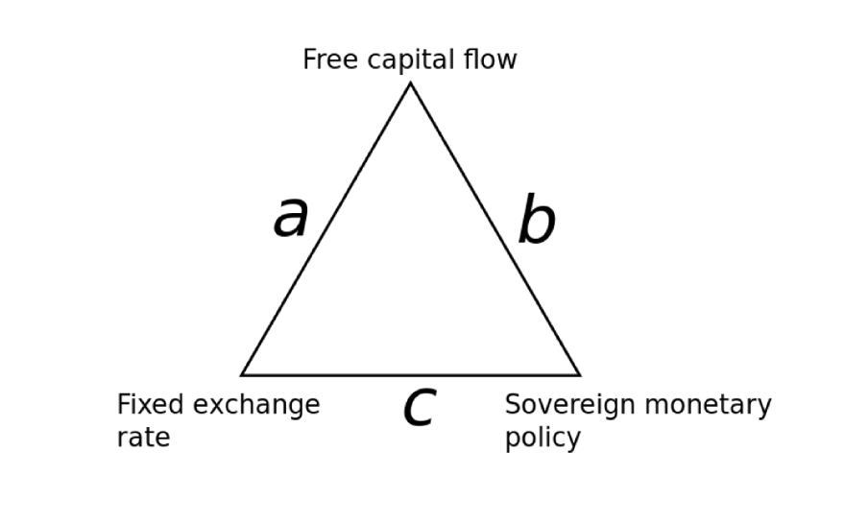
Stable coins
Fiat collateralized
Tether
Crypto collateralized
MakerDAO
Non-collateralized
Basis
Carbon
Virtual world
Altcoins
Import Computational power
Bitcoin
Real world
Export services

Slide 25
Stable coins
Virtual world
Altcoins
Import Computational power
Bitcoin
Real world
Export services

